Slide 1
The Relational Model

Slide 2
Relational Databases
A relational database is a collection of tables OR collection of relations
Each entity is stored in its own table
Attributes of an entity become the fields or columns in the table
Relationships are implemented through common columns in two or more tables
Should not permit multiple entries (repeating groups) in a table

Slide 3
Relational Databases (continued)
Relation: two-dimensional table in which:
Entries are single-valued
Each column has a distinct name (called the attribute name)
All values in a column are values of the same attribute
Order of columns or rows is immaterial
Each row is distinct

Slide 4
Relational Database -Tables:
Describes or models to the business
Made of columns or attributes
Consist of rows of data (Tuples) that are uniquely identified from other rows of data.
Are the logical and perceived data structure

Slide 5
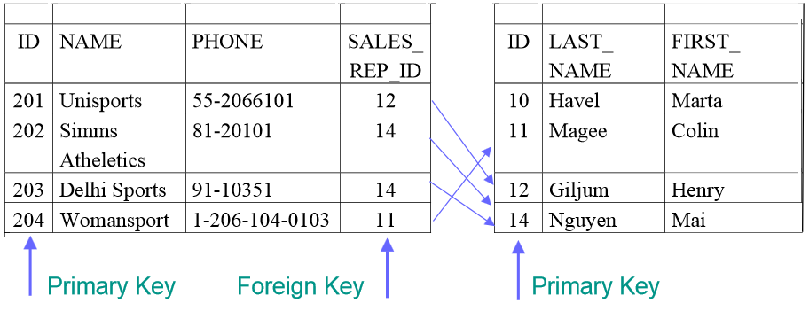
Relational Database
Each row of data in a table is uniquely identified by a primary key (PK).
You can logically relate Data from multiple tables using foreign keys (FK).

Slide 6
Primary Key
A primary key (PK) column or set of columns that uniquely identifies each row in a table
Each table must have a primary key and a primary key must be unique
A PK consisting of multiple columns is called a composite Primary Key
No part of the PK can be null

Slide 7
Foreign Key
A foreign key (FK) is a column or combination of columns in one table that refers to a primary key in the same or another table
A FK must match an existing primary key value
(or else be null)
If a FK is part of a primary key, that FK cannot be null

Slide 8
Data Integrity Constraints
Entity:
No part of the primary key can be NULL and the value must be unique
A NULL is the absence of a value

Slide 9
Data Integrity Constraints
Referential:
A set of validation rules applied to an entity or table such as uniqueness constraints, domain validation of columns or correspondence of foreign keys to the primary key of the related table

Slide 10
Data Integrity Constraints
Unique - each record in table must have a PK with a unique value
Domain - range of possible values for an individual column or attribute
Referential Integrity - each value for a FK within a table must correspond to the value of one record’s PK in the Foreign table or be a NULL column
Values in column must match the defined data type

Slide 11
ER-Model
ER Model: a model that I use to describe the entities and the relationship between these entities (Entities, Relationships, Attributes)
The component of ER Model:
Entities: Are Specific persons, places, events, objects that the user wants to keep data
EX: Employee, Office, Conference, Orders, Parts
Attributes: Are the Properties that used to describe the Entity.
EX: EMPLOYEE entity may have the attributes:
Name, SSN, Address, Gender, BD

Slide 12
Different type of Relationships in ER-Diagram
Relationships: is a the relation between 1, 2 or more distinct entities
(1 entity – Unary, 2 entity – Binary, 3 and more- Ternary)
Re-Cursive Relationship: IT’s the relationship between the entity and it self.
EX: The WORKER supervise the Workers
WORKER
supervise

Slide 13
Different type of Relationships in ER-Diagram
Binary Relationships: is a the relation between 2 distinct entities
Ex: EMPLOYEE Sam Works on the PROJECT XYZ
OR
EMPLOYEE Linda Manages the Research DEPARTMENT
OR
STUDENT Frank Study COURCES

Slide 14
Example of Ternary Relationship
The SUPPLIER supply the PARTS to the PROJECT
Entity Entity Entity
Quantity
SUPPLIER
PROJECT
supply
Sup_ID
PARTS
Proj_ID
Parts_Num

Slide 15
Types of Attributes
Simple:
Each Entity has a single atomic value for the attribute
EX: SSN, Gender(m-or-f)
Composite:
The attribute maybe composed of several components(attributes)
EX: Address(Apt#, House#, Street, City, Zip)
Name(FirstNAme, MiddleNAme, LastName)
Multi-Valued:
An entity may have multiple values
EX: Color of a CAR (can be more than 1 color)
Qualifications: Bsc, Msc, Phd

Slide 16
Types of Attributes
Complex Attribute:
It’s a multivalued attribute and at the same time it’s a composite Attribute
EX: Phone (Country Code, AreaCode, PHoneNumber) =➔ Composite
More than 1 phoneNumber=➔ became Multi-valued
Derived Attribute:
The value of an attribute is derived or calculated from another attribute Ex: Age

Slide 17
Attribute
Single/Simple Valued Composite
Gender (M or F) - Address
SSN: 12345
House# Street City State Zip
OR
- Name
FirstName Middle LastName
OR
- Phone
CountryCode AreaCode Phone#

Slide 18
Attribute
Single/Simple Valued Multivalued
Gender (M or F) - Car color
SSN: 12345 (2 colors)
OR
- Qualifications:
Bsc
Msc
Phd

Slide 19
Complex Attribute
Composite Multivalued
Phone is composite
CountryCode AreaCode Phone#
Having two Numbers 734-123- 4567 OR
734- 999-1212
Both Composite and Multivalued attributes creates Complex Attribute

Slide 20
Attribute
Stored Derived
Salary = 1000 NetSalary=(Salary+Bonus)
Bonus= 120
OR
BirthDate Age

Slide 21
ER-Diagram
Entity and Attribute
Entity : as a rectangle shape
Attribute: as an Oval shape
Multi-Valued Attr.(Phone)
Composite Attribute: (Address)
B-Date
Name
SSN
EMPLOYEE
City
Address
Street Name
Phone
ZipCode

Slide 22
ER-Diagram-Continue
Key Attribute:
It’s attribute
that has a unique value that
it’s non repetitive.
Represent it by a solid line under
The unique value
B-Date
Name
SSN
EMPLOYEE
City
Address
Street Name
Phone
Zip Code

Slide 23
ER-Diagram-Continue
Can an Entity has more than 1 key attribute?
Yes – Student ID is Unique same as
the SSN
Student-ID
SSN
STUDENT

Slide 24
ER-Diagram-Continue
Weak Entity: it’s an entity that it doesn’t have a Key attribute
and it’s presence is related to another Entity
Or it relies on another entity
Non of the attribute can be
a unique or a key since the fields
Can repeat.
To represent a Weak Entity,
double line around the entity
Meaning, if I don’t have the EMPLOYEE entity, there’s no need to the Dependent entity since it’s there and depends on the EMPLOYEE entity
Name
Gender
Age
Dependent

Slide 25
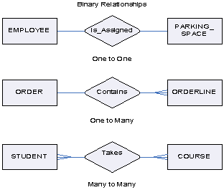
Constrains on a Relationship
Cardinality of Relationship
It means that how many instances of an entity relate to one instance of another entity.
Controlled by Business rules

Slide 26
Cardinality of Relationship
One-to-One 1:1
Each entity in the relationship will have exactly one related entity
One-to-Many 1:M
An entity on 1 side of the relationship can have many related entity, but the entity on the other side will have Only 1 related entity
Many-to-Many M:N
Entity on both sides of the relationship, 1 side will have many entity and it related entities on the other side

Slide 27
Conceptual Data Model
A conceptual data model identifies the highest-level relationships between the different entities.
It describes the structure of the data to be stored in the database without specifying how and where it will be physically stored.
Features of conceptual data model include:
Includes the important entities and the relationships among them.
No attribute is specified.
No primary key is specified.
The figure below is an example of a conceptual data model.

Slide 28
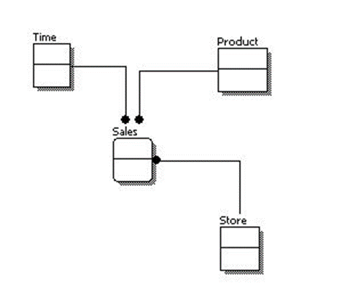
Conceptual Data Model
From the figure we can see that the only information shown via the conceptual data model is the entities that describe the data and the relationships between those entities. No other information is shown through the conceptual data model.

Slide 29
Logical Data Model
A logical data model describes the data in as much detail as possible, without regard to how they will be physical implemented in the database. Features of a logical data model include:
Includes all entities and relationships among them.
All attributes for each entity are specified.
The primary key for each entity is specified.
Foreign keys (keys identifying the relationship between different entities) are specified.
Normalization occurs at this level.

Slide 30
Logical Data Model
The steps for designing the logical data model are as follows:
Specify primary keys for all entities.
Find the relationships between different entities.
Find all attributes for each entity.
Resolve many-to-many relationships.
Normalization.
The figure below is an example of a Logical Data Model.

Slide 31
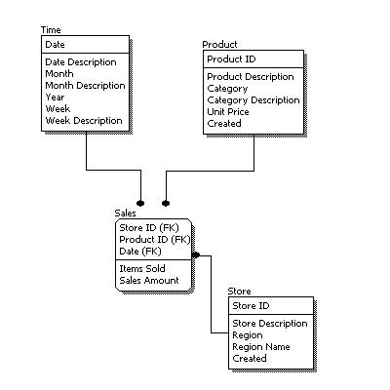
Logical Data Model

Slide 32
Logical Data Model
Comparing the logical data model shown above with the Conceptual
diagram, we see the main differences between the two:
In a logical data model, primary keys are present, whereas in a conceptual data model, no primary key is present.
In a logical data model, all attributes are specified within an entity. No attributes are specified in a conceptual data model.

Slide 33
Logical Data Model
Relationships between entities are specified using primary keys and foreign keys in a logical data model. In a conceptual data model, the relationships are simply stated, not specified, so we simply know that two entities are related, but we do not specify what attributes are used for this relationship.

Slide 34
Physical Data Model
Physical data model represents how the model will be built in the database. A physical database model shows all table structures, including column name, column data type, column constraints, primary key, foreign key, and relationships between tables. Features of a physical data model include:
Specification all tables and columns.
Foreign keys are used to identify relationships between tables.

Slide 35
Physical Data Model
Denormalization may occur based on user requirements.
Physical considerations may cause the physical data model to be quite different from the logical data model.

Slide 36
Physical Data Model
The steps for physical data model design are as follows:
Convert entities into tables.
Convert relationships into foreign keys.
Convert attributes into columns.
Modify the physical data model based on physical constraints / requirements.

Slide 37
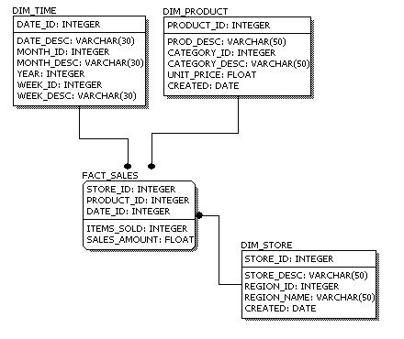
Physical Data Model

Slide 38
Physical Data Model
Comparing the physical data model shown above with the logical data model diagram, we see the main differences between the two:
Entity names are now table names.
Attributes are now column names.
Data type for each column is specified. Data types can be different depending on the actual database being used.

Slide 39
Conceptual, Logical, and Physical Data Models
The three levels of data modeling, conceptual data model, logical data model, and physical data model, were discussed in prior sections. Here we compare these three types of data models. The table below compares the different features:
Feature | Conceptual | Logical | Physical
Entity Names | ✓ | ✓
Entity Relationships | ✓ | ✓
Attributes |  | ✓
Primary Keys |  | ✓ | ✓
Foreign Keys |  | ✓ | ✓
Table Names |  |  | ✓
Column Names |  |  | ✓
Column Data Types |  |  | ✓

Slide 40

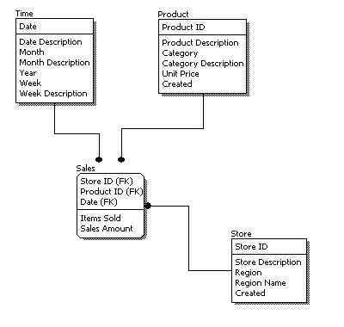
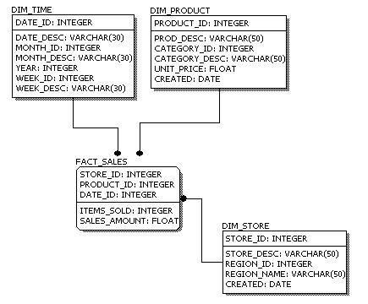
Conceptual, Logical, and Physical Data Models
Conceptual Model Design
Logical Model Design
Physical Model Design

Slide 41
Conceptual, Logical, and Physical Data Models
- We can see that the complexity increases from conceptual to logical to physical.
- This is why we always first start with the conceptual data model (so we understand at high level what are the different entities in our data and how they relate to one another), then move on to the logical data model (so we understand the details of our data without worrying about how they will actually implemented), and finally the physical data model (so we know exactly how to implement our data model in the database of choice). In a data warehousing project, sometimes the conceptual data model and the logical data model are considered as a single deliverable.

Slide 42
E-R Modeling vs. Dimensional Modeling
What is Difference between E-R Modeling and Dimensional Modeling.?
Basic diff is E-R modeling will have logical and physical model. Dimensional model will have only physical model. * E-R modeling is used for normalizing the OLTP database design. * Dimensional modeling is used for de-normalizing the
ROLAP/MOLAP design.

Slide 43
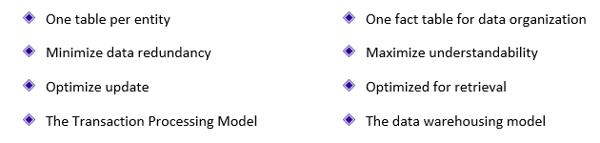
E-R Modeling vs. Dimensional Modeling
Entity-Relationship vs. Dimensional Models

